Slide 1
ESP32 et Pont H
Ajout de Librairie PS4 pour connection de avec Manette Ps4 pour le control de robot et de drivers pour televerser le code en esp32

Slide 2
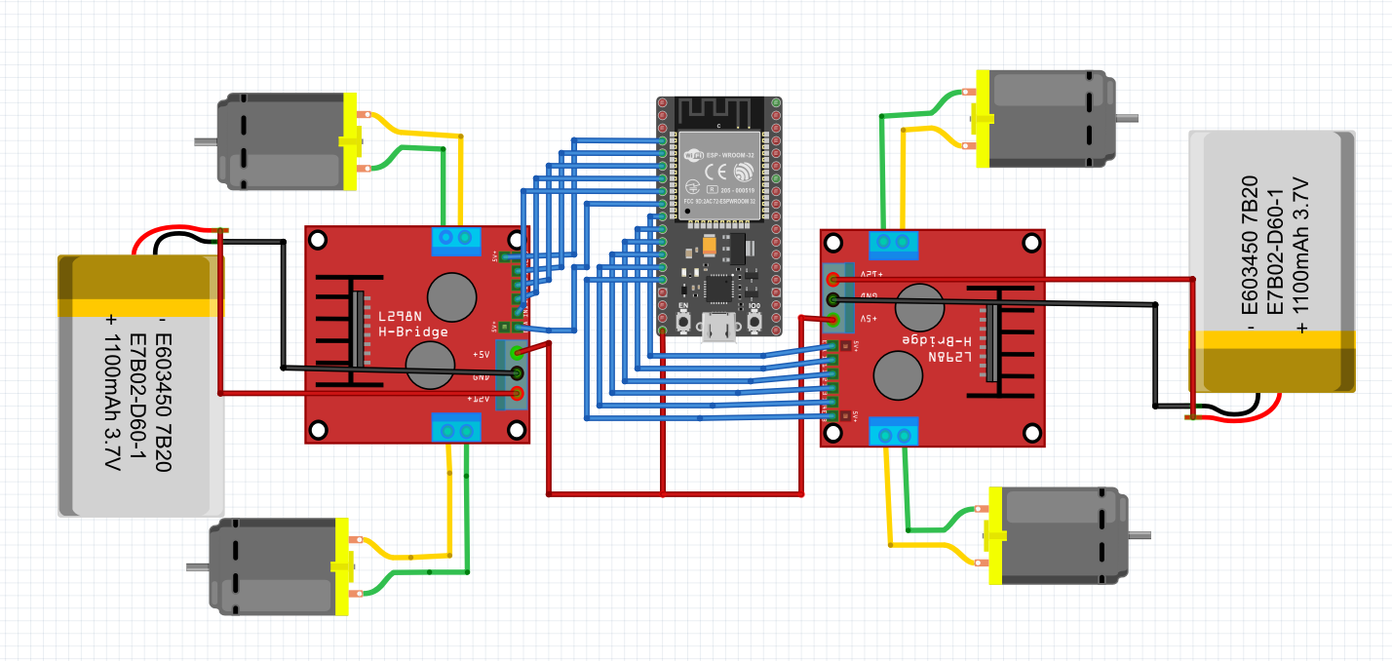
Exemple de cablage pour 2 pont H

Slide 3
Definition des Pines
void setup()
{
pinMode(rm1,OUTPUT);
pinMode(rm2,OUTPUT);
pinMode(lm1,OUTPUT);
pinMode(lm2,OUTPUT);
pinMode(v1,OUTPUT);
pinMode(v2,OUTPUT);
Serial.begin(115200);
PS4.begin("e8:61:7e:58:16:ce");//08:3a:f2:52:e0:4e`
Serial.println("Ready.");
}
#define rm1 14
#define rm2 27
#define lm1 12
#define lm2 13
#define v1 25
#define v2 26

Slide 4
Definition des Fonctions
void DROITE_MAX(){
digitalWrite(rm1, HIGH);
digitalWrite(rm2, LOW);
digitalWrite(lm1, LOW);
digitalWrite(lm2, HIGH);
analogWrite(v1,255);
analogWrite(v2,255);
}
void GAUCHE_MAX(){
digitalWrite(rm1, LOW);
digitalWrite(rm2, HIGH);
digitalWrite(lm1, HIGH);
digitalWrite(lm2, LOW);
analogWrite(v1,255);
analogWrite(v2,255);
}
void AVANT_MAX(){
digitalWrite(rm1, HIGH);
digitalWrite(rm2, LOW);
digitalWrite(lm1, HIGH);
digitalWrite(lm2, LOW);
analogWrite(v1,255);
analogWrite(v2,255);
}
void ARRIERE_MAX (){
digitalWrite(rm1, LOW);
digitalWrite(rm2, HIGH);
digitalWrite(lm1, LOW);
digitalWrite(lm2, HIGH);
analogWrite(v1,255);
analogWrite(v2,255);
}

Slide 5
Program Principales
else if ( PS4.Left() )
{
DROITE_MAX();
Serial.print ("gauche");
Serial.print ("\n");
}
else if (PS4.Right() )
{
GAUCHE_MAX();
Serial.print ("droite");
Serial.print ("\n");
}
else{
STOP();
Serial.print ("stop");
Serial.print ("\n");
}
}
}
void loop()
{
if (PS4.isConnected()){
if( PS4.Up())
{
AVANT_MAX();
Serial.print ("avant");
Serial.print ("\n");
}
else if(PS4.Down() )
{
ARRIERE_MAX();
Serial.print ("arrière");
Serial.print ("\n");
}

Slide 6
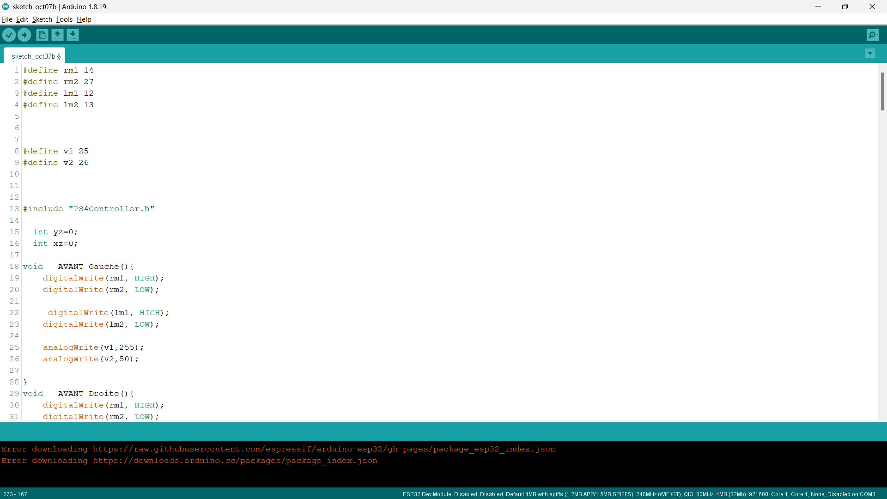

Slide 7
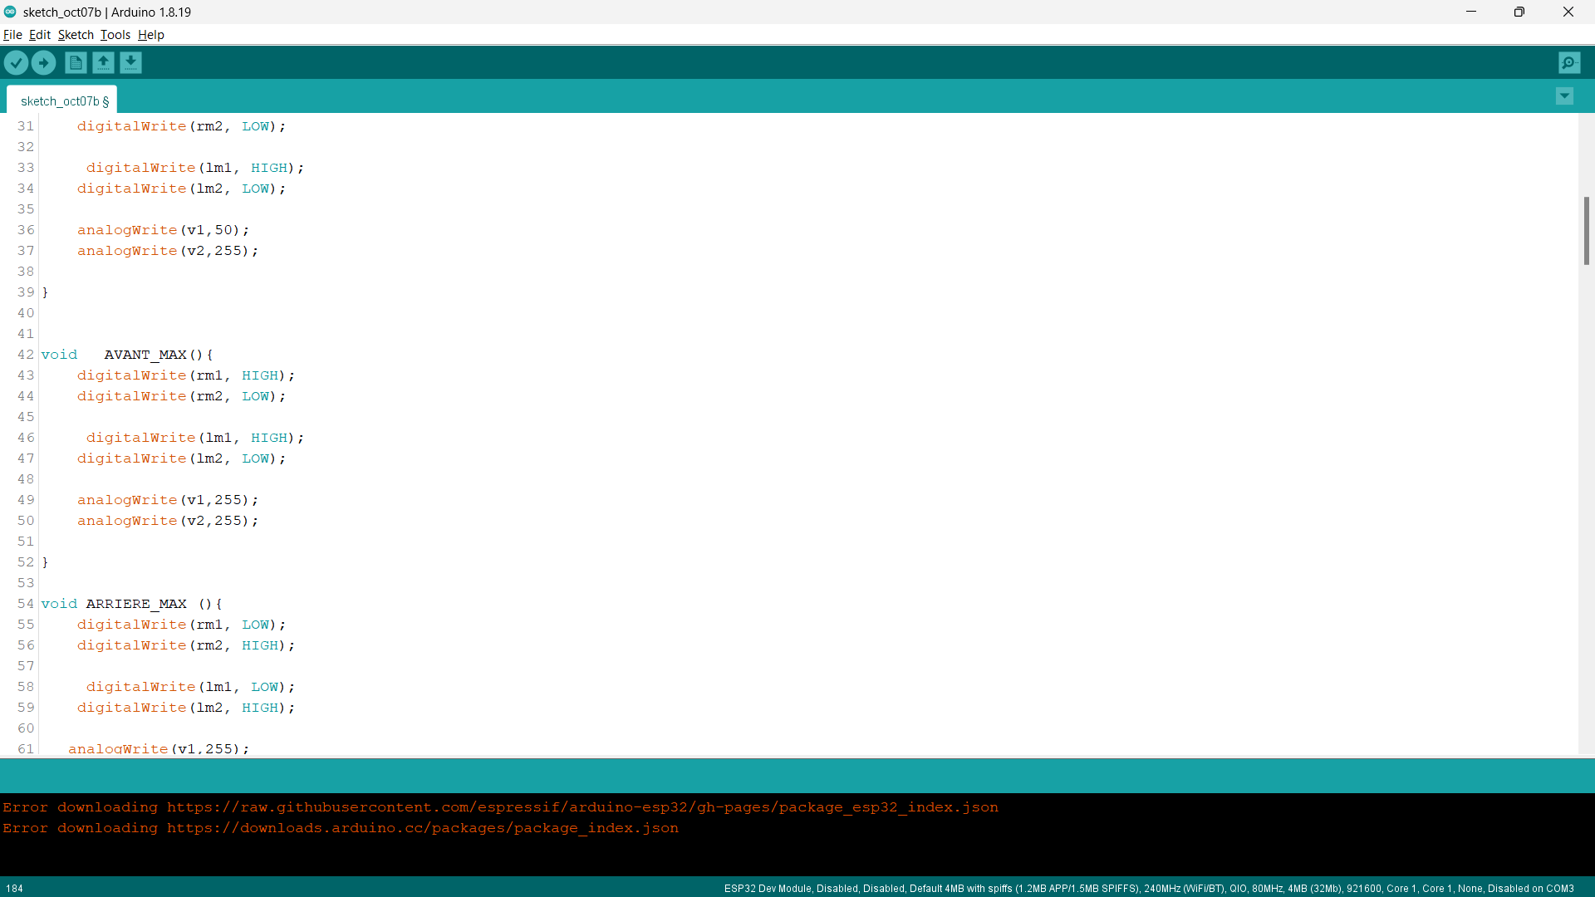

Slide 8
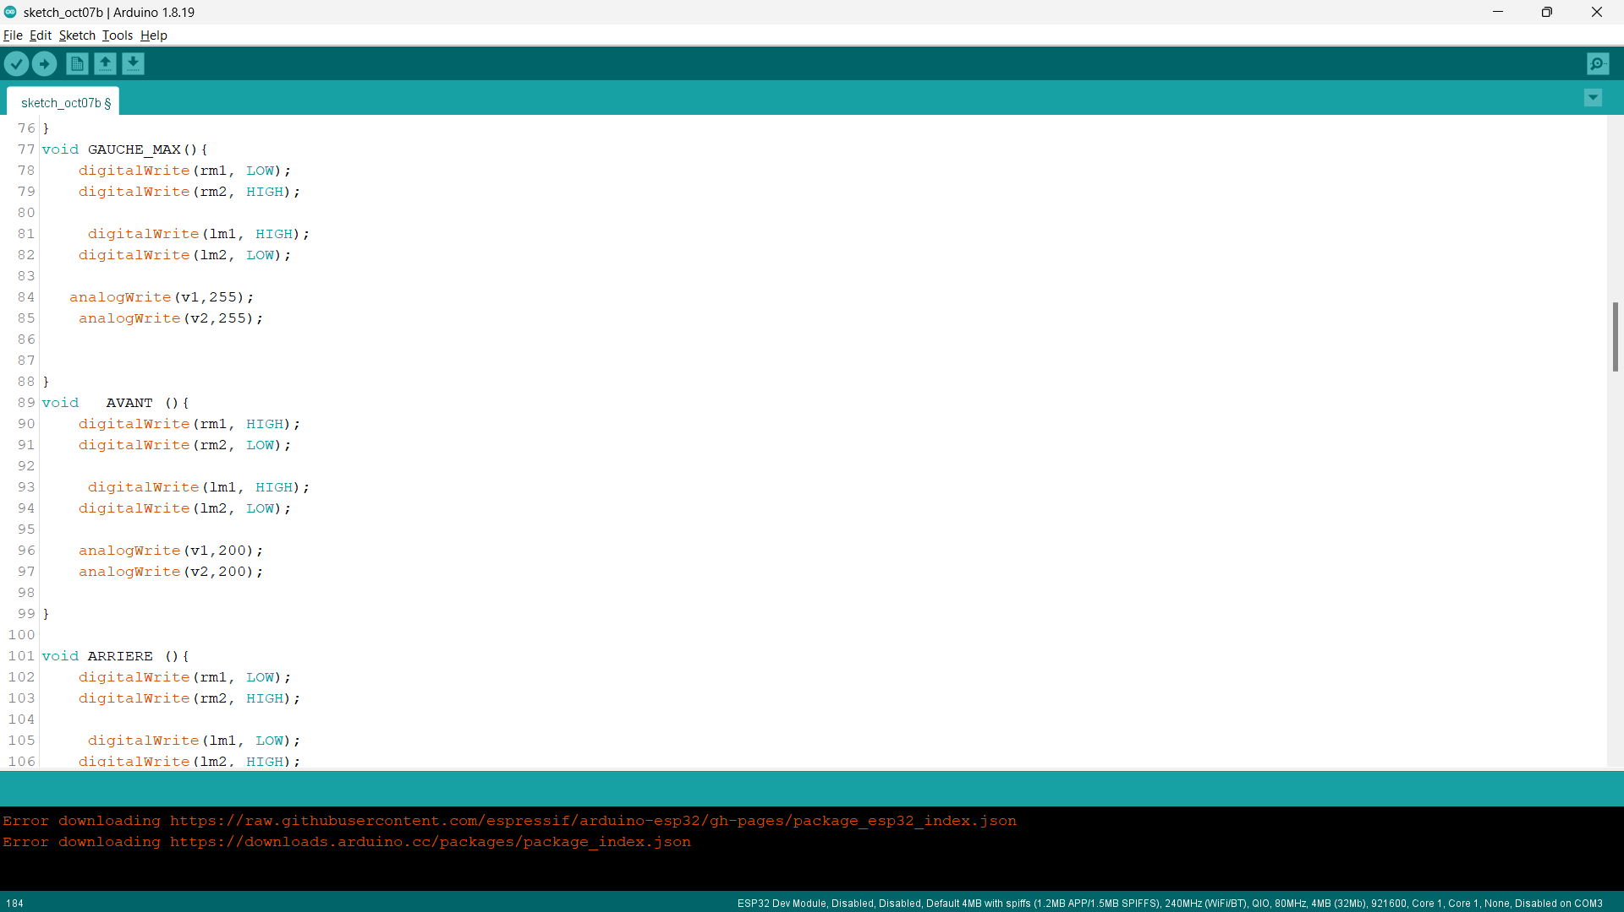

Slide 9
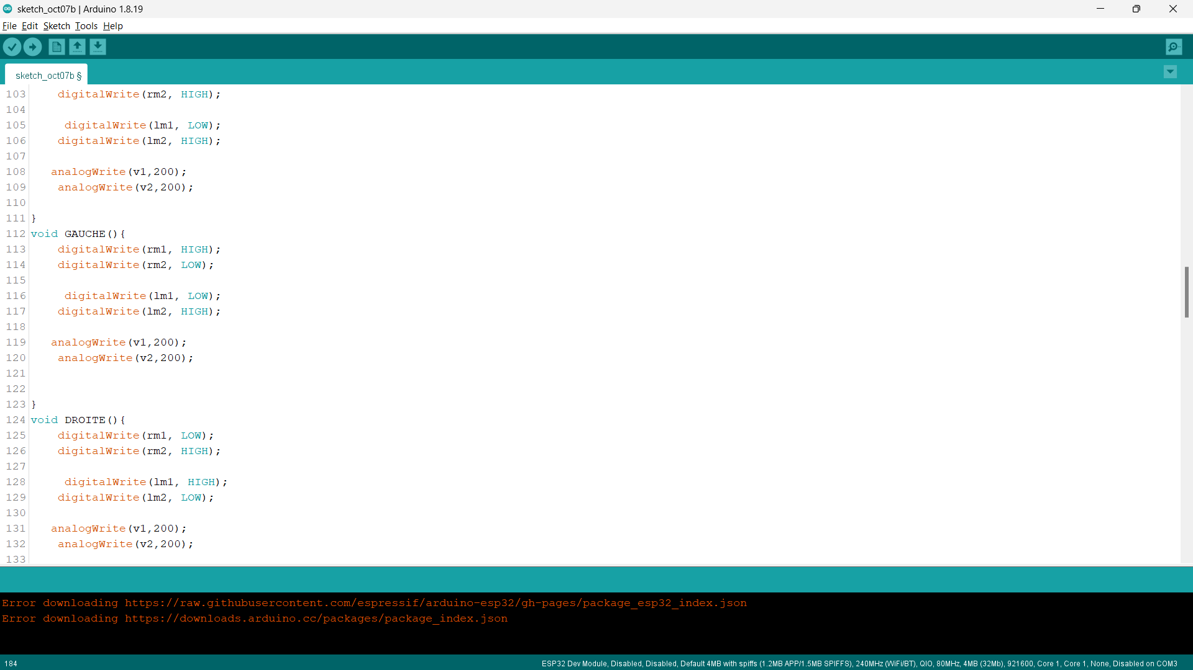

Slide 10
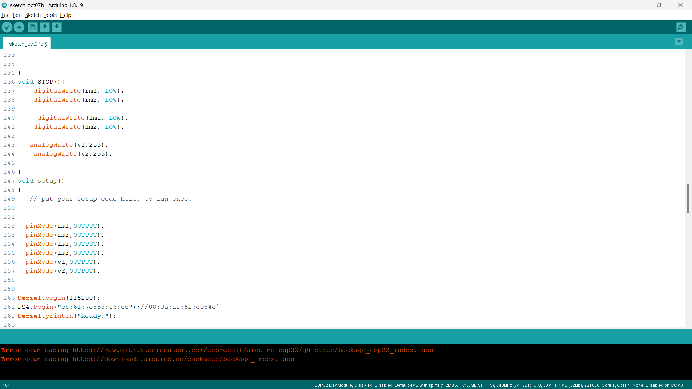

Slide 11
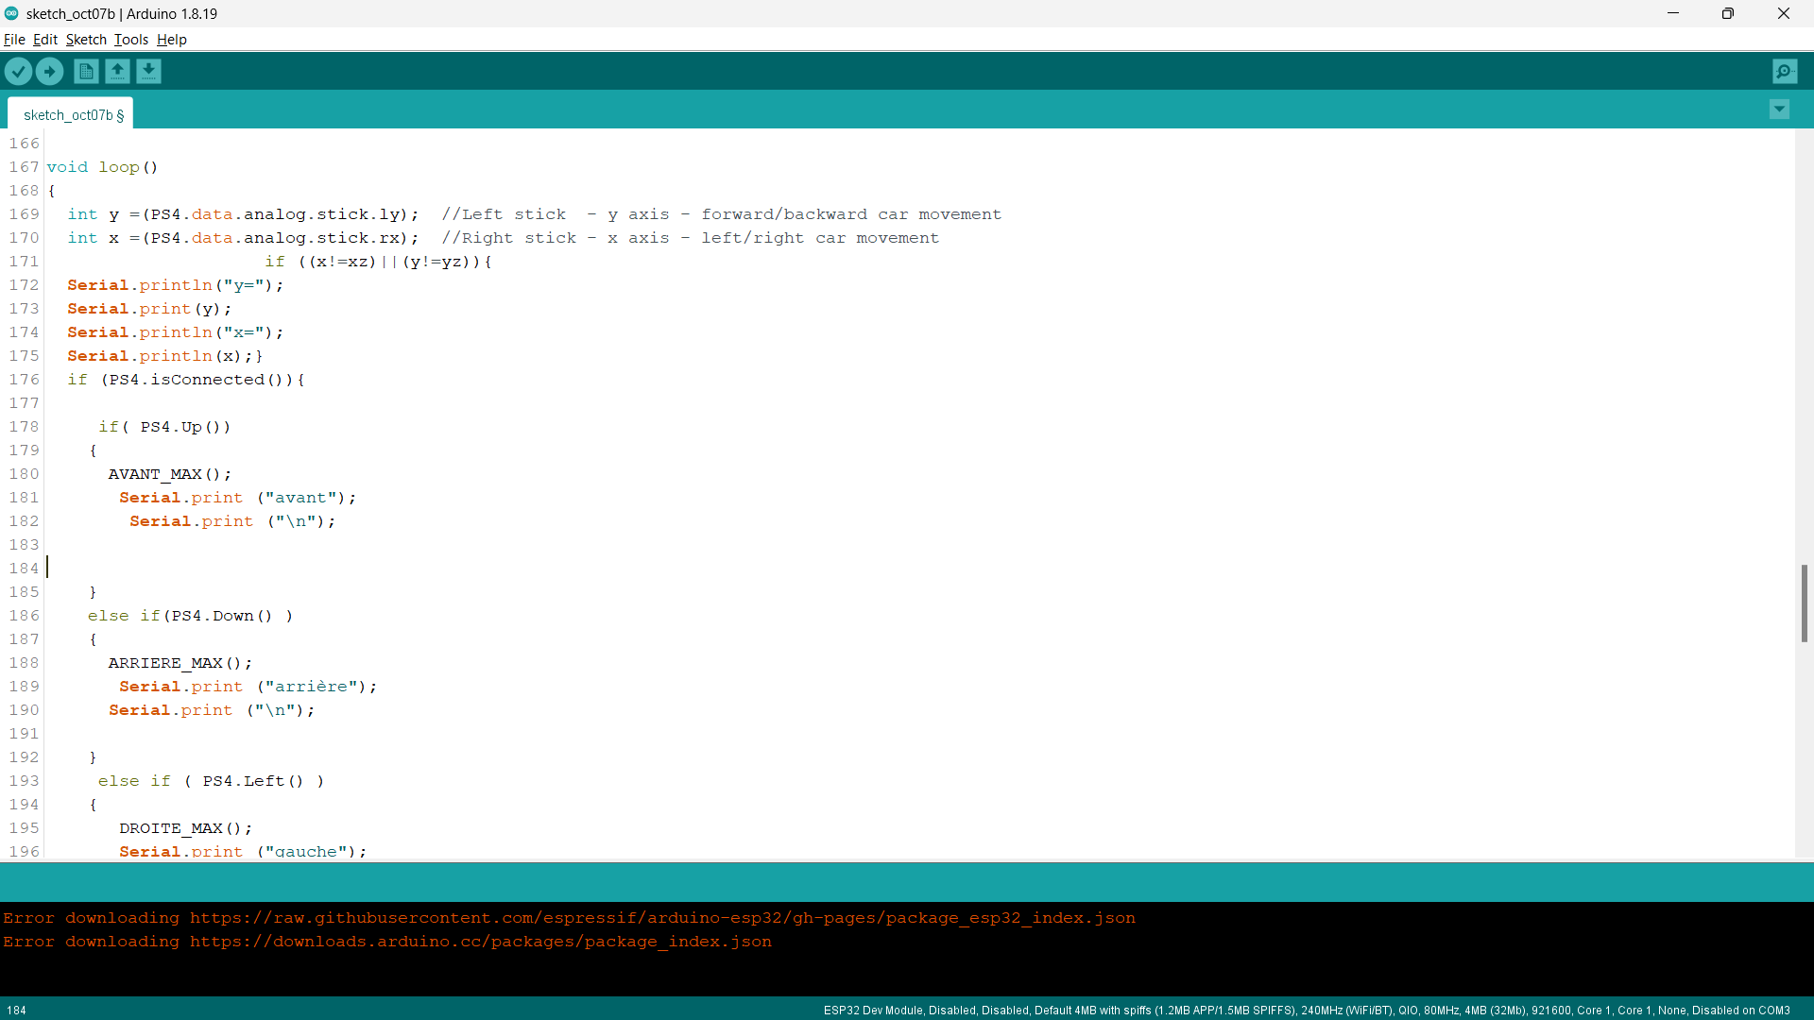

Slide 12
